Slide 1
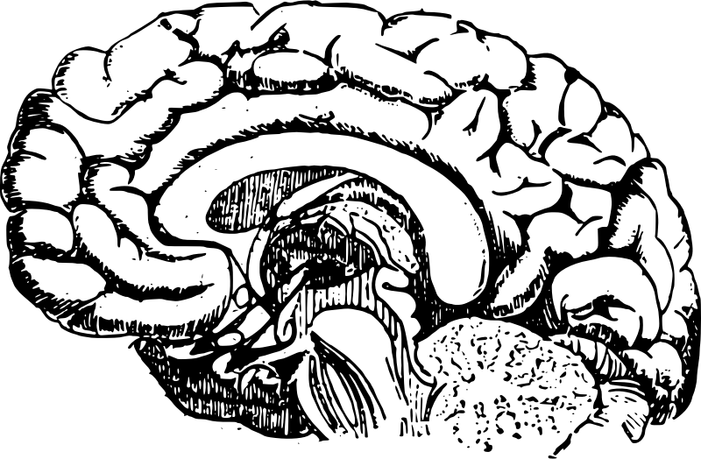

Recitation 9: Smart Pointers in C++

Slide 2
Goals
C++ memory management.
We all learned C++ in CSCI 1300/2270.
Today, we will learn an important aspect of memory management in C++.
Just skimming the surface, we will provide more references.
You have to go look them up on your own.
Use smart pointers in your next C++ project to learn more.

Slide 3
“Raw” Pointers
char * pointer_name = & variable_name;
int * my_int = new int(5);

Slide 4
“Raw” Pointers require manual management of memory
int * my_int = new int(5);
delete my_int;
int * my_int_arr = new int[10];
delete[] my_int_arr;
Notes:
https://stackoverflow.com/questions/106508/what-is-a-smart-pointer-and-when-should-i-use-one

Slide 5
Problems with Raw Pointers: Manual memory management
Class A {
int * ptr;
A(): ptr(new int(30)) {} // Initialize ptr
A(A const& a): ptr(a.ptr){} // copy constructor
~A(){ delete(ptr) } // delete the pointer.
}
See a problem?
Notes:
Walk through constructor, copy constructor and destructor.
Ask students what each of them does.
Ask them if they see a problem.
Give a few minutes to discuss.

Slide 6
Problems with Raw Pointers (Answer)
Class A {
int * ptr;
A(): ptr(new int(30)) {} // Initialize ptr
A(A const& a): ptr(a.ptr){} // copy constructor
~A(){ delete(ptr) } // delete the pointer.
}
A * a = new A();
A * b = new A(*a); // Copy constructor
delete(b); // b -> ptr is deleted but so is a-> ptr
delete(a); // a -> ptr is deleted but double delete.
Notes:
Walk them through the issue.

Slide 7
Problems with Raw Pointers # 2: Manual memory management
Class A {
int * ptr;
A(): ptr(new int(30)) {} // Initialize ptr
A(A const& a): ptr(a.ptr){} // copy constructor
// Look ma: no delete!!
}
See a problem?
Notes:
Here is a proposed solution. Same code but no destructor.
Does it solve the problem? Does it create a new problem?
Talk about the memory leak in this program.

Slide 8
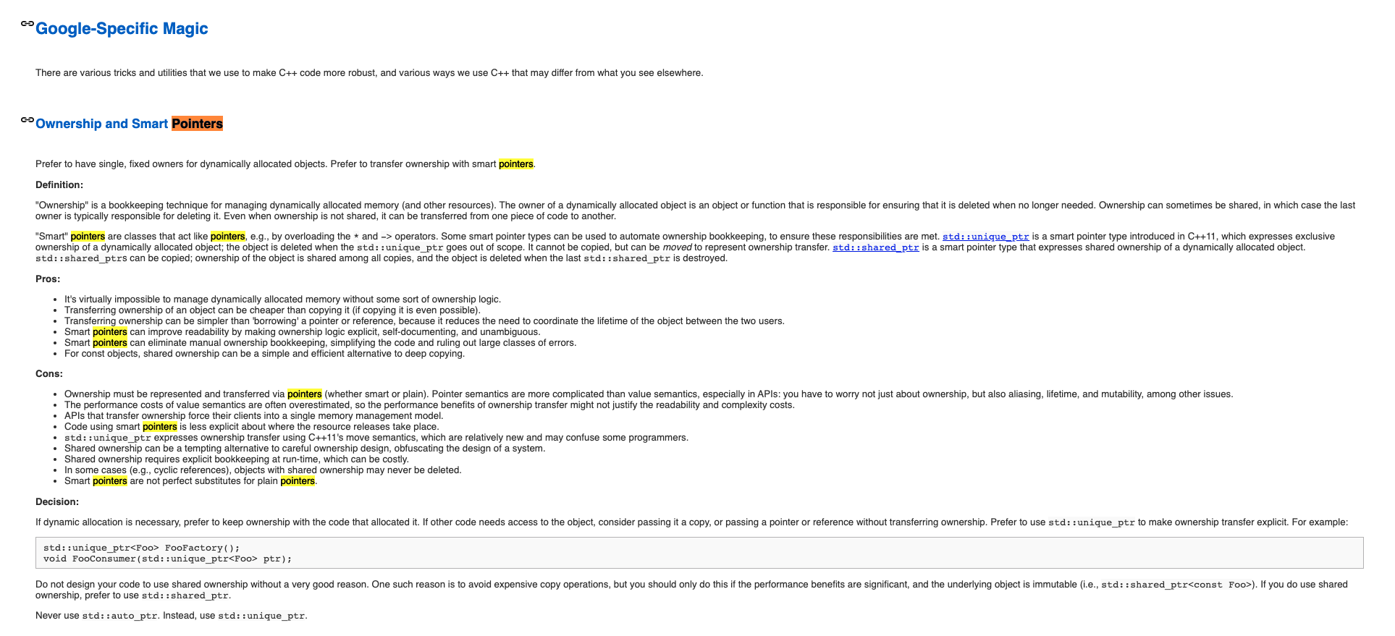
Interested in being a professional C++ programmer???
Read a company’s style guide: https://google.github.io/styleguide/cppguide.html
Notes:
This is just FYI: companies have detailed style guide -- google’s C++ style guide is super famous and used by a lot of developers. Recommended reading.

Slide 9
Solution # 1 : Use simply destructible objects
Class A {
std::vector<int> vec; // Use a STL vector instead of array
A(): vec(30, 0) {} // Initialize ptr to size 30 with 0s
A(A const& a): vec(a.vec){} // copy constructor
// No destructor needed: vec is automatically destructed
}
Full copy (deep copy) - Expensive!
Notes:
One solution is not to use pointers. But that is not always possible.
Here, we use a STL vector instead of a pointer. Ask students to read it carefully and comment on it. Take a few minutes here.
Point out the issue here when you make a deep copy of ptr.
https://stackoverflow.com/questions/11348376/std-vector-c-deep-or-shallow-copy

Slide 10
Solution # 2: Smart Pointers
std::unique_ptr
Std::shared_ptr
std::weak_ptr
Notes:
Smart pointers are now a standard feature of C++. They are quite useful -- we will tell you more about them today.

Slide 11
Smart Pointer : Example 1
A * raw_ptr = new A(); // alloc. an instance of A
// make it a shared pointer
std::shared_ptr<A> ptr ( raw_ptr );
ptr -> call_function();
(*ptr).call_function();
//No need to delete raw_ptr or ptr
Creating raw_ptr is not a good idea.
Use std::make_shared to directly call the constructor and make a shared pointer
std::shared_ptr<A> ptr = std::make_shared<A>();
Notes:
Here is an example of using a smart pointer called “shared_ptr” instead of the raw pointer.

Slide 12
Smart Pointer: Example 2
class A {
shared_ptr<int> ptr; // instead of int *, use a shared_ptr<int>
A(): {
this-> ptr = make_shared<int>(30); // calls new int(30) internally!
}
A(A const& a): ptr(a.ptr){} // copy constructor
// No destructor needed: ptr is automatically destructed
}
Notes:
Here is how we would program class A using a smart pointer.

Slide 13
What is a smart pointer?
Smart Pointer Object
Memory being
pointed to
Raw pointer
Reference Count
Overloaded operators “*”,
“->”,
“[]”,...
Smart pointers wrap around the “raw pointer”.
Takes care of sharing and will automatically call delete when it goes out of scope.
User does not work with raw pointer once a smart pointer is created.
Notes:
Discuss make_shared, make_unique, avoiding new and delete entirely in your code as a way to ensure raw pointers are not used.

Slide 14
Smart Pointers Come in Many Types
Shared smart pointer: “shared_ptr<T>”
Use it when you have many pointers to the same memory location.
Unique smart pointer: “unique_ptr<T>”
Use it when you guarantee that only one pointer will point to memory at a time.
This supports an important programming paradigm of single ownership.
Weak pointer: “weak_ptr<T>”
weak_ptr will not delete the underlying memory when they go out of scope.
Its relation with shared pointers is similar to the relation between peek() and pop() operations for Stack, if we imagine stack elements as memory cells.
Notes:
https://stackoverflow.com/questions/12030650/when-is-stdweak-ptr-useful

Slide 15
Smart Pointers
They can enforce ownership, eg., with unique_ptr.

Slide 16
Unique Pointers
Only one reference is allowed at any time.
unique_ptr<T> ptr1
Object in memory
Disallowed!
unique_ptr<T> ptr2
int * raw_ptr = new …
std::unique_ptr<int> ptr1 = std::make_unique(raw_ptr);
std::unique_ptr<int> ptr2 = ptr1; // NOT ALLOWED TO COPY a unique pointer.
// use std::move to move a unique pointer from one onto another
std::unique_ptr<int> ptr2 = std::move(ptr1); // Right way -- ptr1 is now invalid.

Slide 17
Smart Pointers
Smart pointers manage memory with reference counting.
When a shared_ptr goes out of scope, the reference count for the object it points to is decremented. Once that count reaches zero, the object is deleted.

Slide 18
Shared Pointers
Shared pointers to same object share a reference count.
shared_ptr<T> ptr1
Object in memory
shared_ptr<T> ptr2
shared_ptr<T> ptr3
shared_ptr<T> ptr4
shared_ptr<T> ptr5
When last reference goes out of scope, the object is automatically deleted from memory.
Notes:
Void h() {
{
// create a shared pointer to some object A
}
// Object A will be automatically deleted as long as there is not shared pointers to object A
}
Void f() {
// Create a shared pointer to object A
}
Void g() {
f();
// ...
}

Slide 19
Shared Pointers
class A {
A (int x, char y, …)
…
}
//Not advisable
A * raw_ptr = new A( 20, ‘c’,...);
shared_ptr<A> a_shared (raw_ptr);
//Advisable
shared_ptr<A> a_shared = make_shared(20, ‘c’, …);

Slide 20
Problems with shared pointers
Sometimes, programmers may have an unexpected shared pointer reference to a large object.
Eg., a “statistics” object has a shared_ptr reference to a large file contents object.
The object remains in the memory although we could have freed it up and the statistics object is not really necessary/reading that object.
Programmer discipline is needed in tracking which objects hold shared_ptr references to other objects.
Cyclic references are a problem and strictly discouraged.
Notes:
Use weak pointers for cyclic references, and use scoping and shared pointers to keep objects in memory (this is a scope-based, high-level self-management of memory).

Slide 21
Problem with Shared_ptr: Cyclic References
Shared pointers may create cyclic references
Object1
Object2
std::weak_ptr<A> partner;
Object2 -> partner = &Object1;
Const std::weak_ptr<A> get_partner() const { return partner;}
OR ??
Const std::shared_ptr<A> get_partner() const { return partner.lock();}
Object1
Object2
Weak pointers break cyclic references

Slide 22
Weak Pointers
When a weak_ptr goes out of scope, nothing happens. If the object pointed to by a weak_ptr has not been deleted, it is possible to promote it to a shared_pointer using std::weak_ptr<T>::lock.
Notes:
https://en.cppreference.com/w/cpp/memory/weak_ptr/lock

Slide 23
Weak Pointers
auto sp = std::make_shared<int>(42)
auto up = std::make_unique<int>(42)
auto up_vec = std::make_unique<std::vector<int>>();
Why no make_weak?
Notes:
https://en.cppreference.com/w/cpp/memory/weak_ptr/lock

Slide 24
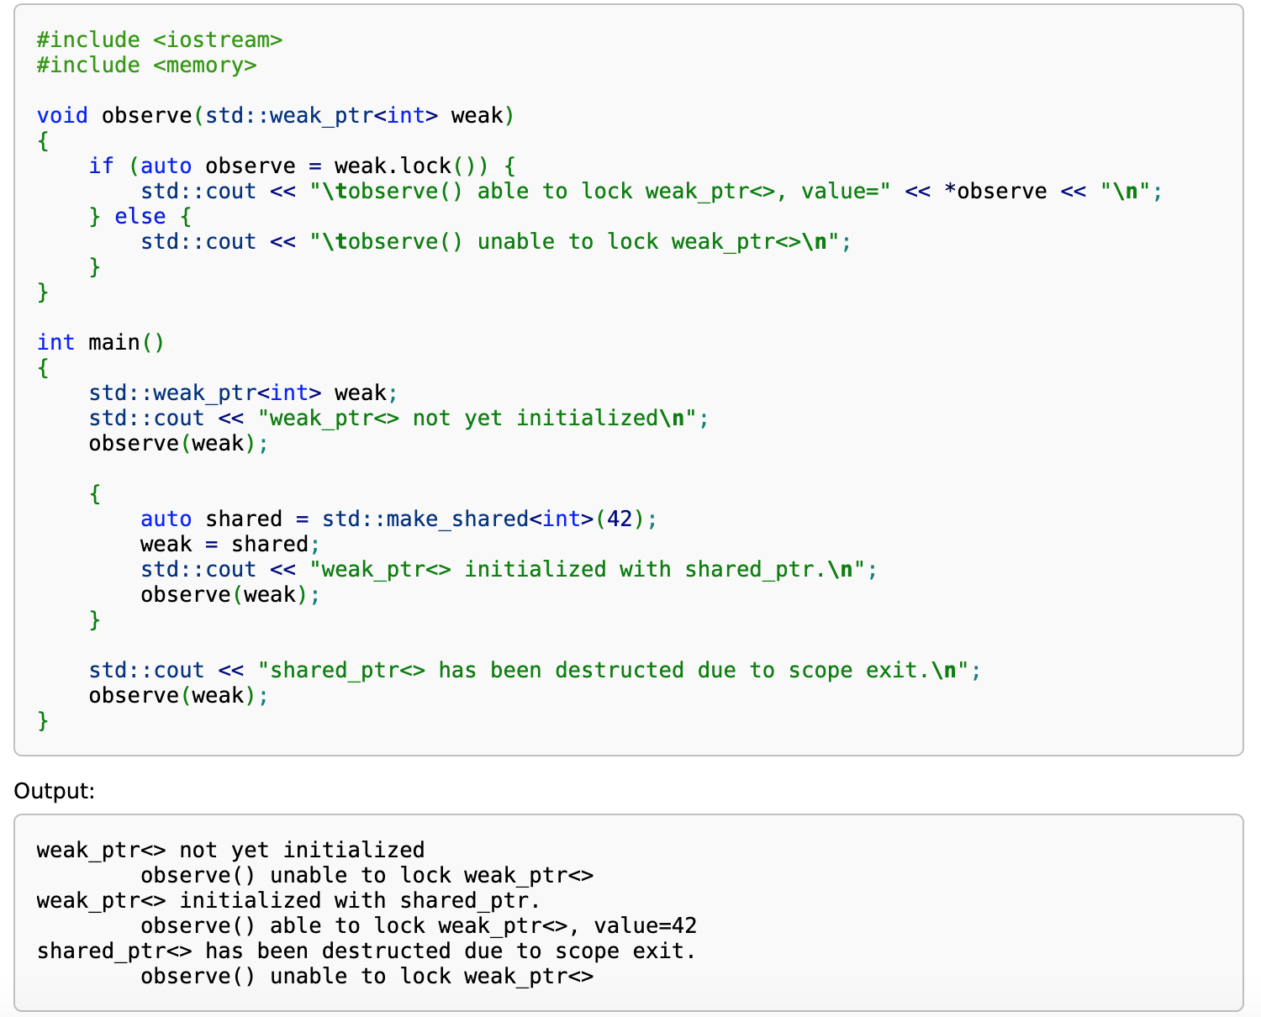
Example
https://en.cppreference.com/w/cpp/memory/weak_ptr/lock
Notes:
https://en.cppreference.com/w/cpp/memory/weak_ptr/lock

Slide 25
Further Readings
https://docs.microsoft.com/en-us/cpp/cpp/smart-pointers-modern-cpp
https://en.wikipedia.org/wiki/Resource_acquisition_is_initialization

